Slide 1

Cost of Quality
Dr. Shamim H Ripon
CSE430 Software Testing & Quality Assurance
CSE, East West University

Slide 2

What is Cost of Quality (COQ)?
Cost of quality (COQ) is made up of expenses incurred to meet a target quality level for a product or service, plus any costs incurred when that level of quality is not met, and corrective actions need to be made.
COQ identifies an organization’s costs related to quality conformance and non-conformance.

Slide 3
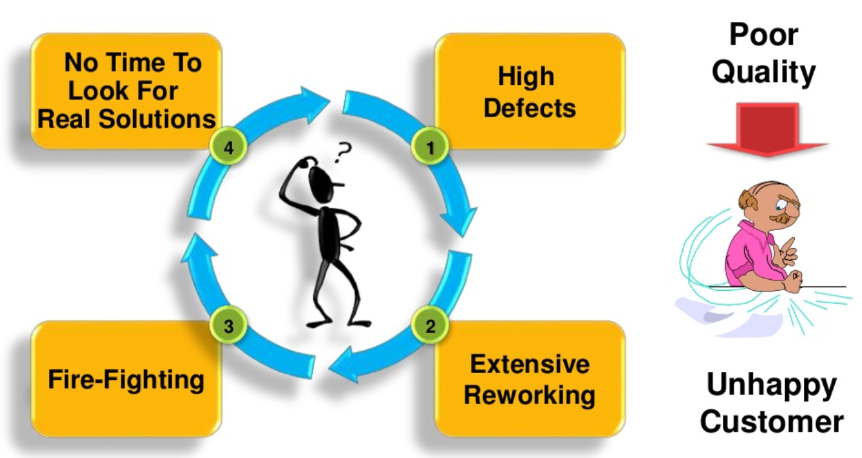
Vicious Cycle of Poor Quality

Slide 4
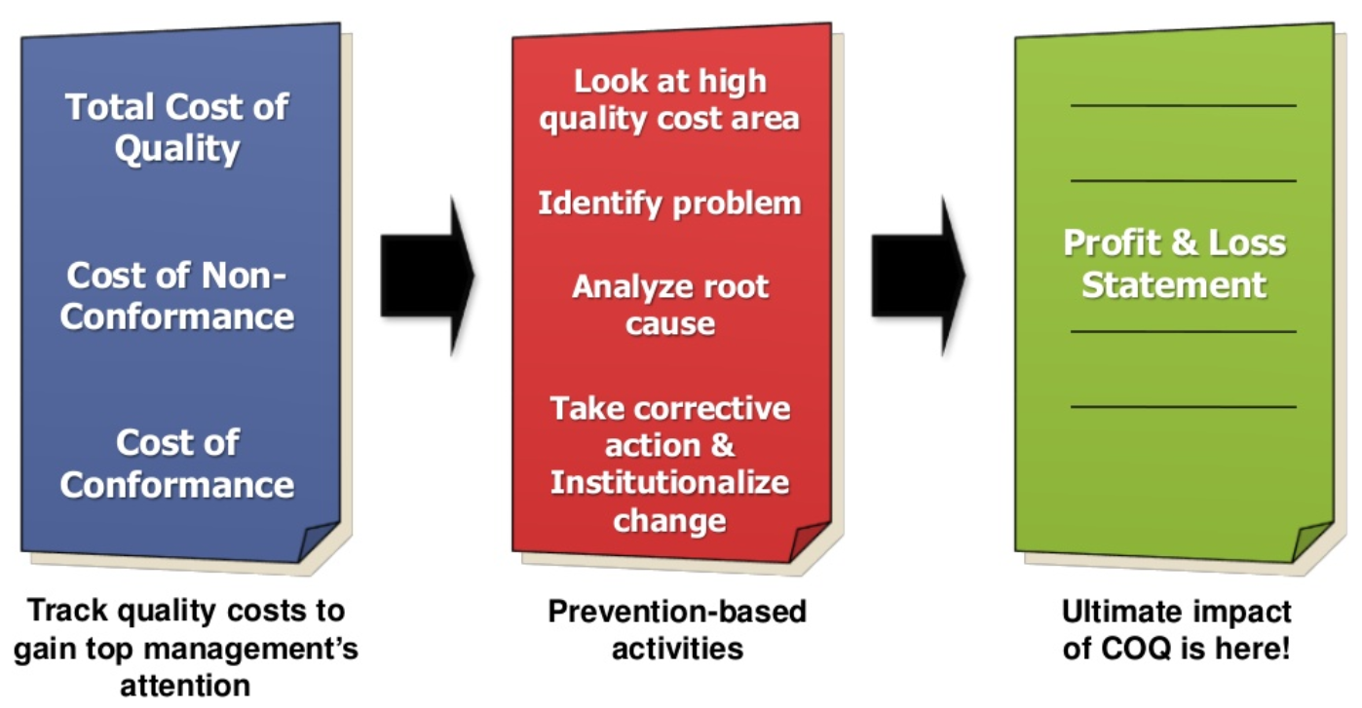
Link Between Quality Costing & Profit

Slide 5
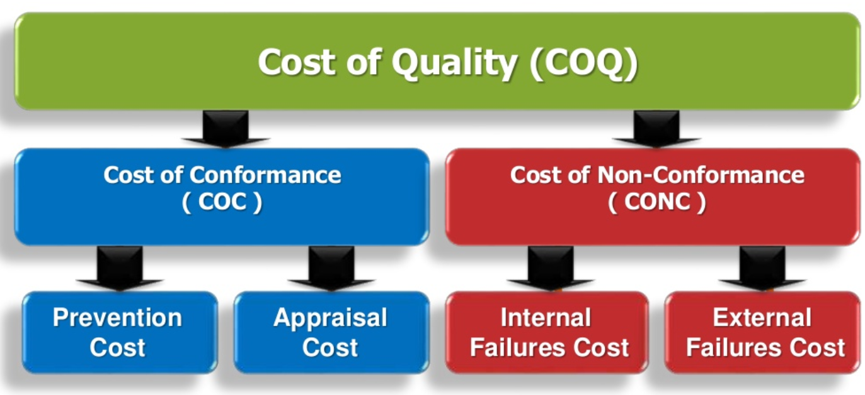
Cost of Quality Components

Slide 6
Prevention Costs
Prevention costs support activities whose purpose is to reduce the number of defects
The most effective way to manage quality costs is to avoid having defects in the first place.
It is less costly to prevent a problem from ever happening than it is to find and correct the problem after it has occurred.
The cost arises from efforts to prevent defects.

Slide 7
Prevention Costs
Investments in development of new or improved SQA infrastructure components or, alternatively, regular updating of those components:
Procedures and work instructions
Support devices: Template, checklists, etc.
Software configuration management system
Software quality metrics
Regular implementation of SQA preventive activities:
Instruction of new employees in SQA subjects and procedures related to their positions
Instruction of employees in new and updated SQA subjects and procedures
Certification of employees for positions that require special certification
Consultations on SQA issues provided to team leaders and others.
Control of the SQA system through performance of:
Internal quality reviews
External quality audits by customers and SQA system certification organizations
Management quality reviews

Slide 8
Appraisal Costs
Appraisal costs support activities whose purpose is to determine the degree of conformance to the quality requirements
Any defective parts and products should be caught as early as possible in the production process.
Sometimes called inspection costs.
The cost arises from efforts to detect defects

Slide 9
Appraisal Costs
Examples
Reviews:
Formal design reviews (DRs)
Peer reviews (inspections and walkthroughs)
Expert reviews.
Costs of software testing:
Unit tests
Integration tests
Software system tests
Acceptance tests (participation in tests carried
out by the customer).
Costs of assuring quality of external participants (by means of design reviews and software testing). Activities performed by:
Subcontractors
Suppliers of COTS (Commercial Off-The-Shelf) software systems and reusable software modules
The customer as a participant in performing the project.

Slide 10
Internal Failure Cost
Internal failure costs are those incurred when correcting errors that have been detected by design reviews, software tests and acceptance tests performed before the software has been installed at customer sites.
Internal failure costs represent the costs of error correction subsequent to formal examinations of the software during its development.
Costs of redesign or design corrections due to design review and test findings
Costs of re-programming or correcting programs in response to test findings
Costs of repeated design review and retesting (regression tests).
Rework
Delays
Re-designing
Shortages
Failure analysis
Re-testing
Downgrading
Downtime
Lack of flexibility and adaptability

Slide 11
External Failure Cost
External failure costs entail the costs of correcting failures detected by customers or maintenance teams after the software system has been installed at customer sites.
Resolution of customer complaints during the warranty period.
Correction of software bugs detected during regular operation.
Correction of software failures after the warranty period is over even if the correction is not covered by the warranty.
Complaints
Repairing goods and redoing services
Warranties
Customers’ bad will
Losses due to sales reductions
Environmental costs

Slide 12
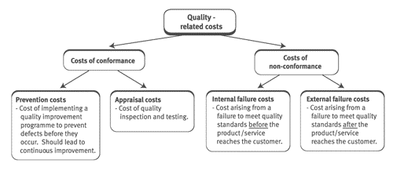

Slide 13
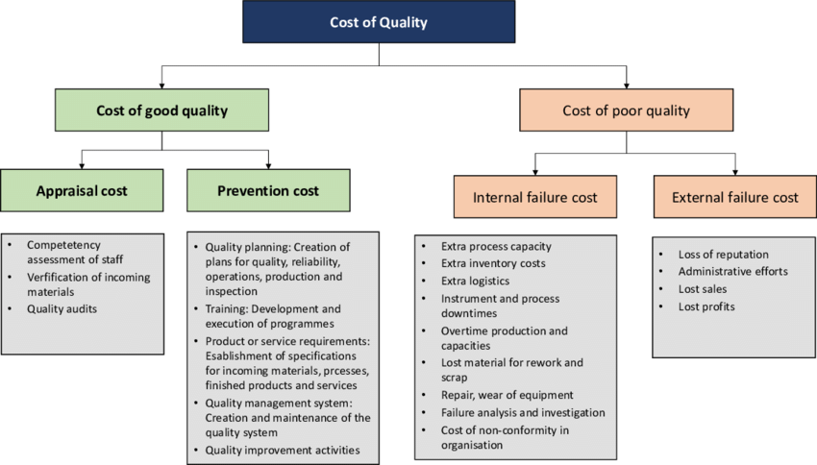

Slide 14
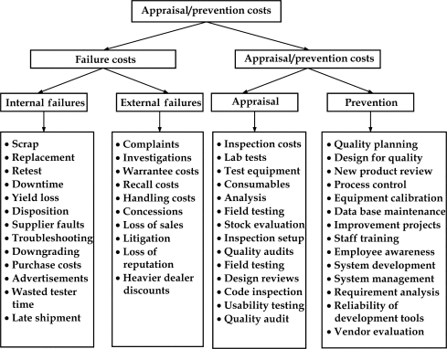
Cost of Quality

Slide 15
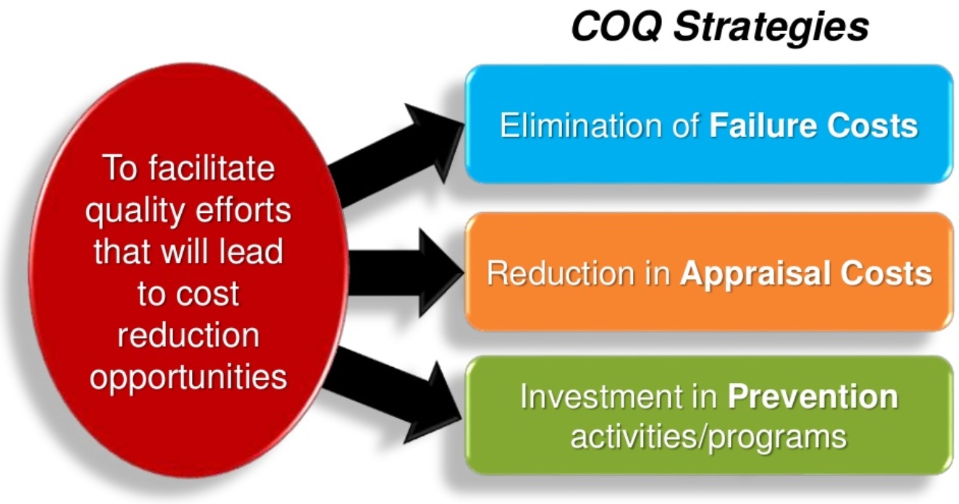
Goal of COQ System

Slide 16
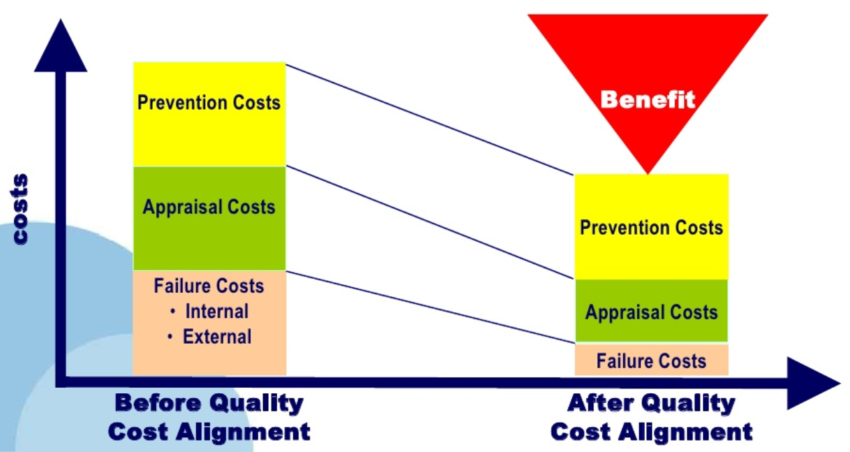
Quality Cost Alignment

Slide 17
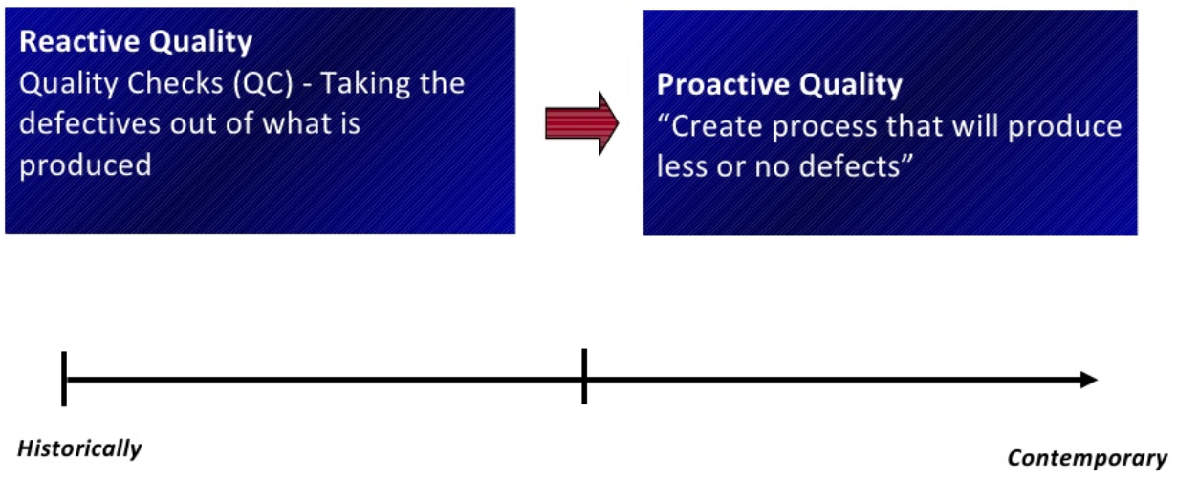
Evolution of Quality

Slide 18
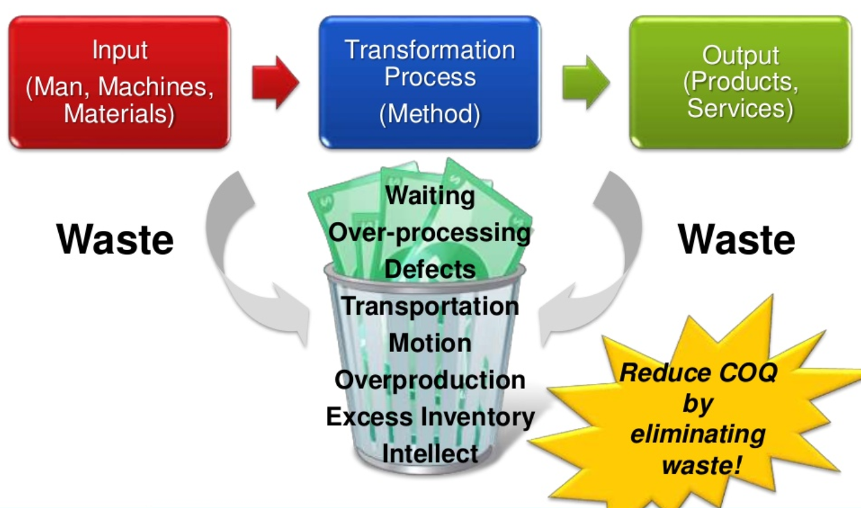
COQ and Waste Elimination

